Slide 1
GS500 Literature Search and Analysis
Presented by Ranga Rodrigo

Slide 2
Topics for Today
Some general tips on research
Purpose of the literature search
Finding literature
Analyzing literature
Bibliography managers

Slide 3
What Is the Dominant KPI (GOAL) of a Research?
PUBLICATIONS.
However, know that the process of making you an independent researcher is what is truly important.

Slide 4
Why Write?
To reserve knowledge.
For reproducibility.

Slide 5
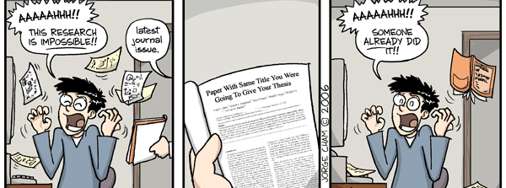
Do the Literature Search as Early as Possible
http://phdcomics.com/comics/archive.php/archive/archive.php?comicid=789

Slide 6
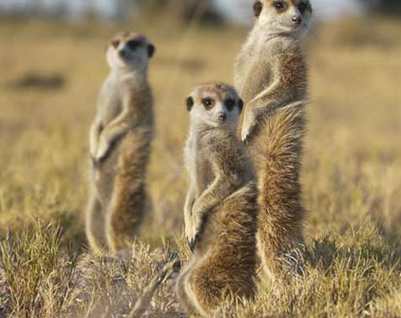
GOOD WRITING IS IMMITATION.
See a few well-known papers in the area and the journal.
https://www.tribes.co.uk/Wildlife/meet-the-meerkats
Notes:
Imitation does not mean copying here. It means following the structure, standards, and style appropriate to the particular forum.

Slide 7
START WITH THE END IN MIND
Comparison of results with recent papers in well-known conferences and journals (benchmarks) is a must.
Plan the tables of results before you start experiments.
https://ggia.berkeley.edu/practice/goal_visualization

Slide 8
Structure
I(L)MR(D)C

Slide 9
I(L)MR(D)C: Writing Order [Your Choice, or Is It?]
Results
Methods
Introduction
Conclusion
Abstract
Literature
Notes:
Abstract is not the same as the conclusion. Highlight the difference between the abstract and the conclusion. Abstract is what is the come in the paper, a summary. The conclusion is written in retrospect of what has been presented.

Slide 10
Literature Search: Purpose

Slide 11
Why Literature?
To provide the backdrop
Establish feasibility
Establish novelty (re-inventing wheel)
Understand methods
Understand metrics
Gauge existing results
Expose the research gap

Slide 12
Why Literature?
Suggest ideas for research problems
Identify strengths and weaknesses of others’ theories and work
Identify theories that can be applied
Gather aspects of presenting work: e.g., literature, statistical and graphical treatment
Identify outlets for publishing
To be current!

Slide 13
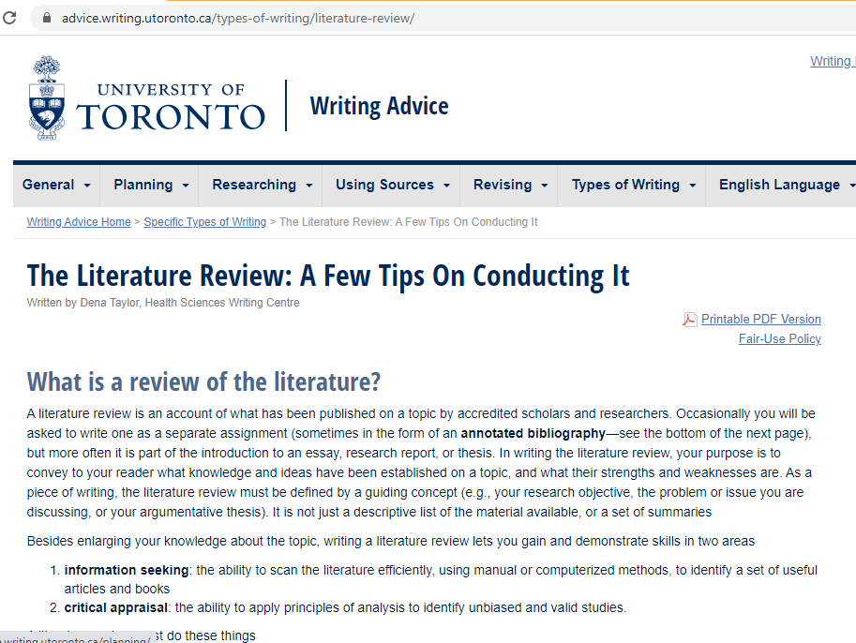
Reading
https://advice.writing.utoronto.ca/types-of-writing/literature-review/
What questions should you ask yourself in doing a literature search?
Notes:
What questions should you ask yourself in doing a literature search?

Slide 14
Literature Review Is Not …
To convince the reader that the writer is knowledgeable of literature.
A laundry list of previous studies:
A compilation of facts and feelings.
A report of everything that you read.
“Smith found . . . ,” “Jones concluded . . . ,” “Anderson stated . . . ,” and so on. This not only is poor writing but also misses the whole point of an effective review of the literature.
Literature is a good servant but a bad master.
Rudestam and Newtorn, Surviving your dissertation: a comprehensive guide to content and process, 4th ed., Sage, 2015.

Slide 15
What Should Literature Review Be, Then …
A dialog between you and the reader.
Argues for the validity of the problem statement.
Anticipates reader’s questions:
“What is your point here?”
“What makes you think so?”
“What is your evidence?” and
“So what?”
Not a compilation of facts and feelings but a coherent argument that leads to the problem studied (research gap).
Attempts to convince the reader of the legitimacy of your assertions by providing sufficient logical and empirical support along the way.
The reader should be able to conclude, “Yes, of course, this is the exact work that needs to be done at this time to move knowledge in this field a little further along.”
Rudestam and Newtorn, Surviving your dissertation: a comprehensive guide to content and process, 4th ed., Sage, 2015.

Slide 16
Quiz 1
What may not be a section in a research article?
a. Conclusion
b. Discussion
c. Method
d. Introduction
e. Results
The literature review is not a compilation of facts and feelings but a coherent argument that leads to the problem studied (research gap).
True
False
What is not a reason for doing a literature search?
a. Establish novelty
b. Establish feasibility
c. To provide the backdrop
d. Expose the research gap
e. Demonstrate knowledge in the field.

Slide 17
Finding Literature

Slide 18
Steps in Writing the Literature Review
Finding and reading relevant articles
Organizing
Associate papers with areas and summarize
Find key areas of knowledge
Provide transitions between areas
Organize them logically
Purpose of each paper
Assumptions
Main claims
Evaluating
Identify the gaps in these papers
How can these papers be applied
Why do the existing papers demand a new solution?
https://ecp.engineering.utoronto.ca/resources/online-handbook/components-of-documents/literature-reviews/

Slide 19
How to Search for Literature
Ask the supervisors. If the supervisor can point you to several key papers in recent well-known journals and conferences specific to your research, the problem is solved.
Know the top journal and conferences in your area.
Specify-and-search, know the topic.
List the questions to be answered
Do key-word searches in Google.
First: use an academic search engine such as Google Scholar or CiteSeer and some well-chosen keywords to find three to five recent.
Do one pass on each to get a sense of the work, then read their related work sections. You will find a thumbnail summary of the recent work, and perhaps, a pointer to a recent survey paper.
Second: Refer to (shared) citations within. These are the key papers and researchers in that area.
Refer to papers that cite these papers.
Then go to the websites of the key researchers and see where they’ve published recently. Identify top conferences and journals.
Third: go to the website for these top conferences and look through their recent proceedings
https://web.stanford.edu/class/ee384m/Handouts/HowtoReadPaper.pdf
Notes:
One pass: later.

Slide 20
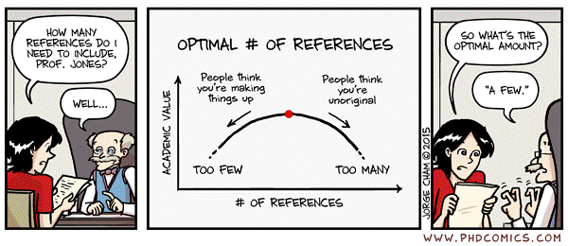
How Many References?
http://phdcomics.com/comics/archive.php/archive/archive.php?comicid=789

Slide 21
Searching for Papers: In-Class Activity
Let’s do this in-class exercise to identify influential papers. Assume the following scenario:
You are interested in embarking on research in the exciting area of computer vision. In a casual chat, a vision researcher mentioned that vision transformers have gained much popularity. You know about Google scholar.
Locate an influential paper in this area following the process outlined in the slides, i.e., identifying papers commonly cited by most recent papers on the topic in question.

Slide 22
Primary vs. Secondary Sources
Primary source | Secondary source
Novel | Article analyzing the novel
Results of an opinion poll | Blog post interpreting the results of the poll
Empirical study | Literature review that cites the study
Conference of journal reporting original results | A review or survey article
A skillful researcher draws on original source material rather than relying on review articles and secondary sources. As a student, you may have to read some secondary sources.
Rudestam and Newtorn, Surviving your dissertation : a comprehensive guide to content and process, 4th ed., Sage, 2015.
https://www.scribbr.com/citing-sources/primary-and-secondary-sources/

Slide 23
Establishing Credibility
What are the major journals and conference in the specialized research field of yours?
Impact factors, quartile (Q1, Q2, etc.), $h$-index, Google Metrics help.
Who is the publisher (a scientific society, well-known publisher, a university or a commercial entity)?
Don’ts:
Do not read new journals not sponsored by a society, at least as a start.
Do not read journals that charge money for publishing, at least as a start.
Do not read journals that are only electronic or only in print, at least as a start.

Slide 24
Measures
Impact Factor
In any given year, the two-year journal impact factor is the ratio between the number of citation received in that year for publications in that journal that were published in the two preceding years and the total number of "citable items" published in that journal during the two preceding years
$${IF}_{y}=\frac{{Citations}_{y}}{{Publications}_{y−1}+{Publications}_{y−2}}$$
Citations matter
Journal impact factor (impact factor)
h-index
Journal Citation Reports (JCR)
Scimago Journal Rank (SJR)
Quartile
$h$-Index (Hirsch Index)
The $h$-index is defined as the maximum value of $h$ such that the given author/journal has published h papers that have each been cited at least h times
$h5$-Index
$h5$-index is the h-index for articles published in the last 5 complete years. It is the largest number $h$ such that $h$ articles published in 2015-2019 have at least $h$ citations each.
$h5$-Median
$h5$-median for a publication is the median number of citations for the articles that make up its $h5$-index
https://www.scimagojr.com/SCImagoJournalRank.pdf
https://www.scimagojr.com/journalrank.php?area=1700&category=1707
https://www.scimagojr.com/journalrank.php?area=2200&category=2208
https://en.wikipedia.org/wiki/Impact_factor

Slide 25
Quiz 2
What are criteria for establishing credibility of a publication?
a. Impact factors, quartile (Q1, Q2), reputation of the publisher.
b. h-index, Google Metrics, authors being from a good university.
c. Quartile (Q1, Q2), high h-index, being within Google Metrics
d. Impact factor being high, quartile (Q1, Q2), high h-index.
A journal published 20 articles in 2018, and 80 articles in 2019. If there were 200 citations in 2020 for article for those article in the last two years, the 2020 two-year impact factor is

Slide 26
Databases and Indices
Web of Science (previously Web of Knowledge) is a website which provides subscription-based access to multiple databases that provide comprehensive citation data for many different academic disciplines. It was originally produced by the Institute for Scientific Information (ISI) and is currently maintained by Clarivate Analytics (previously the Intellectual Property and Science business of Thomson Reuters) (https://clarivate.com/webofsciencegroup/solutions/web-of-science/ )
Journal Citation Reports (JCR): https://clarivate.com/webofsciencegroup/solutions/journal-citation-reports/
Master Journal List (https://mjl.clarivate.com/home )
Science Citation Index Expanded
Social Science Citation Index
Arts & Humanities Citation Index
Emerging Sources Citation Index
Scopus is Elsevier’s abstract and citation database launched in 2004. (https://www.scopus.com/ )
The SCImago Journal Rank (SJR): indicator is a measure of the scientific influence of scholarly journals that accounts for both the number of citations received by a journal and the importance or prestige of the journals where the citations come from. https://www.scimagojr.com/
Google metrics (https://scholar.google.com/citations )

Slide 27
Predatory Journals: How to Detect
Guarantees of publishing in a short duration (say, a week)
Probably charge money for publishing.
Perhaps, no peer review or editing.
Perhaps, they post everything that they get.
Website itself containing mistakes.
Published papers containing silly mistakes.
Newly created indices like “impact index.”
Lack of comprehensive instructions for authors, no indication of peer review process
Listed in Beall’s List (scholarlyoa.com/publishers/ )
Lack of a LaTeX template
Predatory journals provide a forum for those who do not have a forum.

Slide 28
How to Read a Paper?
https://web.stanford.edu/class/ee384m/Handouts/HowtoReadPaper.pdf
The Three-Pass Process
First Pass: Bird’s-Eye View
First pass: gives you a general idea about the paper (10 mins.).
Second pass: lets you grasp the paper’s content, but not its details (one hour).
Third pass: helps you understand the paper in depth (four or five hours for beginners).
1. Carefully read the title, abstract, and introduction
2. Read the section and sub-section headings, but ignore everything else
3. Read the conclusions
4. Glance over the references, mentally ticking off ones you’ve already read
Second Pass: Read with Care
Ignore what you can.
Look at figures, graphs, results. Is the work shoddy or excellent?
Mark relevant unread references for further reading.
After this: should be able to summarize.
Third Pass: Fully Understand
To fully understand a paper, particularly if you are reviewer, requires a third pass. The key to the third pass is to attempt to virtually re-implement the paper.
After this: innovations and failures identified.

Slide 29
Analyzing Literature

Slide 30
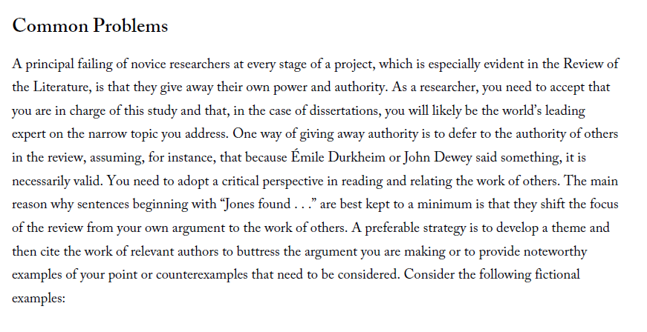
Reading: Power and Authority
How to we keep the focus on the phenomenon?

Slide 31
Projecting Power and Authority
Adopt a critical perspective in reading and relating the work of others.
The strategy is to develop a theme and then cite the work of relevant authors to support the argument, provide noteworthy examples, or counterexamples.
Example 1
Illuminatus (2010) conducted a study on the effects of seasonal light on major depression by comparing the rates of depressive illness among residents of Seattle and San Diego during different times of the year. He hypothesized that there would be more depression in the northern city than the southern city
and more depression during winter than during summer. His findings confirmed his hypotheses.
 | Aspect 1 | Aspect 2 | Aspect 3 | Aspect 4
Author 1
Author 2
Author 3
Author 4
Author 5
Horizontal preferred over vertical.
(Prof. Dias)
Rudestam and Newtorn, Surviving your dissertation : a comprehensive guide to content and process, 4th ed., Sage, 2015.

Slide 32
Projecting Power and Authority
Adopt a critical perspective in reading and relating the work of others.
The strategy is to develop a theme and then cite the work of relevant authors to support the argument, provide noteworthy examples, or counterexamples.
Example 2
There is reason to believe that differences in seasonal light can affect the extent of depressive illness. For
instance, residents of Seattle, a northern city, are reported to have higher rates of depression than residents of San Diego, a southern city, and these differences are accentuated during the winter (Illuminatus, 2010), suggesting that relative darkness may exacerbate mood disorders.
Do not use quotations excessively.
Include that contradict as well.
Rudestam and Newtorn, Surviving your dissertation : a comprehensive guide to content and process, 4th ed., Sage, 2015.

Slide 33
Critiquing a Research Article (Not Just Reporting)
Assumption: the paper is correct.
Aspects Comparable in Critiquing
Problem definition
Methodology
Performance metrics
Application domain
Data set
Validity of theory
Maintain a critical perspective, evaluating the study on its own merits and in comparison with other studies on the same or a similar problem.
Does the methodology warrant the conclusion?
Question the generalizability, i.e., limitations.
Comparison must be fair. Also, use professional language.
Rudestam and Newtorn, Surviving your dissertation : a comprehensive guide to content and process, 4th ed., Sage, 2015.

Slide 34
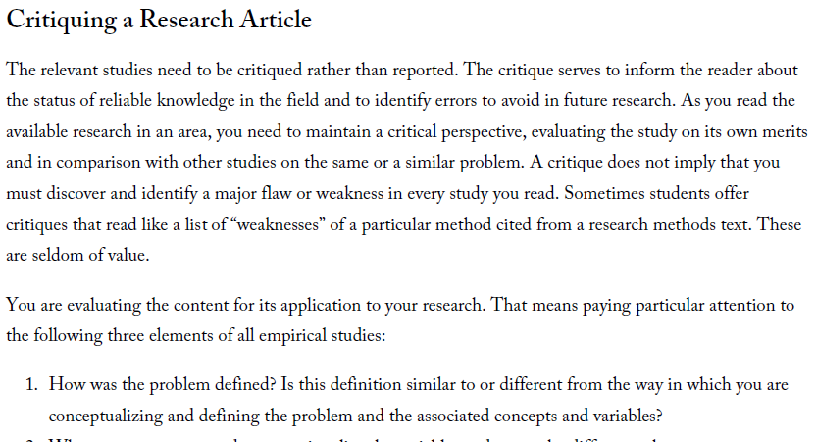
Reading: Critiquing
What are some questions that we can ask in critiquing?

Slide 35
Background, Relevant vs. Very Relevant Literature
Background literature
(classic papers)
Abstract
Introduction
Relevant literature
Literature review
Method
Very relevant literature
(very similar to your work)
Results
Conclusion
Seminal and paradigm-shifting papers.
https://www.pri.org/stories/2019-09-16/small-town-italy-offers-houses-sale-less-espresso

Slide 36
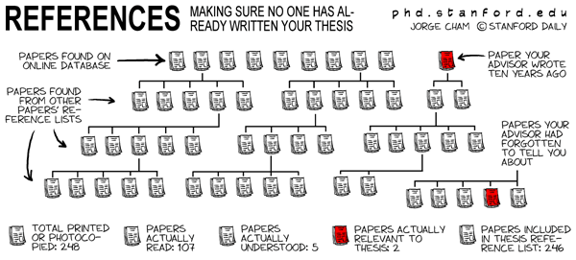
http://phdcomics.com/comics/archive.php?comicid=286

Slide 37
Plagiarism
ALWAYS CITE, in the following cases:
When you quote two or more words verbatim, or even one word in a way unique to the source.
When you introduce facts you have found in a source.
When you paraphrase or summarize ideas, interpretations, or conclusions that you find in a source.
When you introduce information that is not common knowledge or that may be considered common knowledge in your field, that the reader may not know it.
When you borrow the plan or structure of a larger section of a source’s argument (e.g., using a theory from a source and analyzing the same three case studies that the source uses).
When you build on another’s method found either in a source or from collaborative work in a lab.
When you build on another’s program in writing computer code or on a not-commonly-known algorithm.
When you collaborate with others in producing knowledge.
Plagiarism is the use of another’s work, words, or ideas without attribution. The word “plagiarism” comes from the Latin word for “kidnapper” and is considered a form of theft, a breach of honesty in the academic community.
Three main categories:
Using a source’s language without quoting
Using information from a source without attribution, and Paraphrasing a source in a form that stays too close to the original.
https://poorvucenter.yale.edu/writing/using-sources/understanding-and-avoiding-plagiarism/what-plagiarism

Slide 38
Reference Managers
Citation Styles
EndNote,
Reference Manager
RefWorks
Mendeley
IEEE style (Institute of Electrical and Electronics Engineers): numbered e.g., [1].
APA style (American Psychological Association): author-date, e.g., Schmidt and Oh (2016), (Schmidt & Oh, 2016)
MLA Style Manual (Modern Language Association): author-page.
Chicago style (Chicago Manual of Style): author-date, author-date-page.
Harvard style
https://web.archive.org/web/20180915145204/https://library.sydney.edu.au/subjects/downloads/citation/Harvard_Complete.pdf

Slide 39
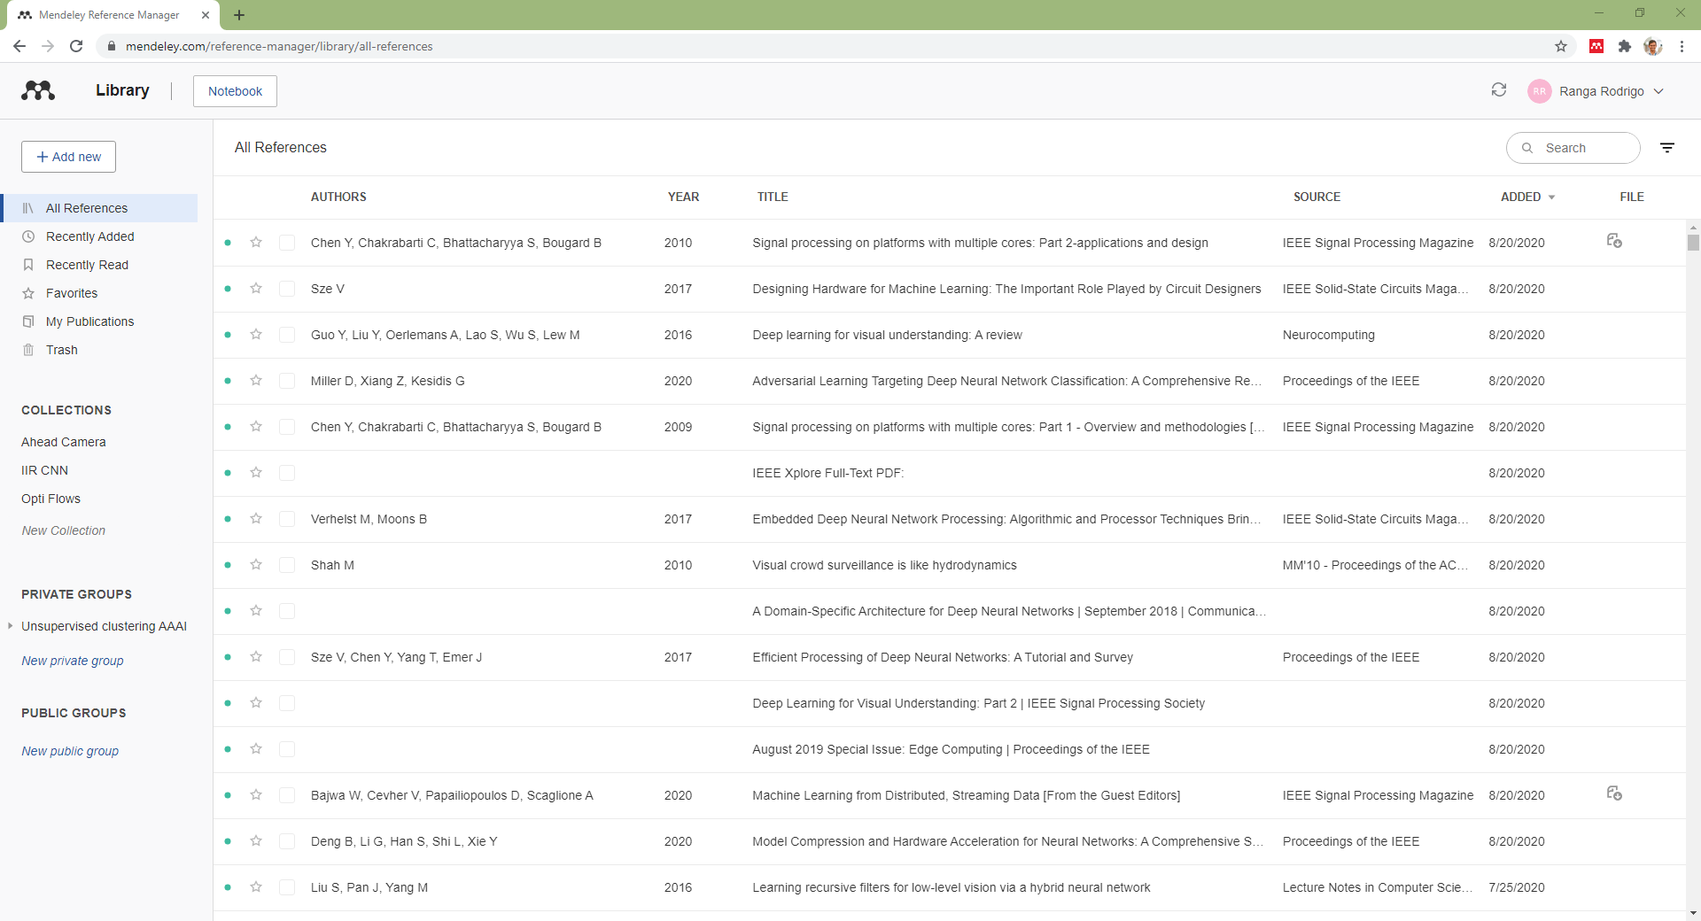

Slide 40
Literature Search Summary
Purpose: to know the state-of-the-art.
A congruent argument.
Projecting authority.
Background, relevant and very relevant literature.
Where to cite?
Writing the literate review: styles, citing, bibliographies.

Slide 41
More References
Literature Reviews: https://ecp.engineering.utoronto.ca/resources/online-handbook/components-of-documents/literature-reviews/
How to give a great research talk: https://www.microsoft.com/en-us/research/academic-program/give-great-research-talk/
Acknowledgement
The author thanks Dr. Prathapasinghe Dharmawansa for insightful discussions.

